Slide 1


ANALYZING THE RISK OF PATIENTs BASED ON ELECTRONIC PATIENT RECORD
Presented by: Savitha Mamidiyala
Mentor: Somya Mohanty

Slide 2
background
Electronic patient records or Electronic Health records (EHRs)
Assist clinicians with patient management and in allocating finite resources.
To extract clinically relevant patient vital signs and laboratory results for increased predictive value in patient outcome
Electronic patient records could be used in estimating the risk for their mortality
Hospitals can be assessed for efficiency based on
mortality rate of admitted patients
Readmissions over time

Slide 3
Introduction
Goal:
“Predict how patient responds to the high-risk medications and analyze the mortality”
Aims
Use electronic health records for Dataset preparation
Compare and contrast machine learning models for classification performance
Identify key features contributing to the models for mortality

Slide 4
Related Work
Hamid et al : Forecasting Mortality Risk for Patients Admitted to Intensive Care Units Using Machine Learning
Applied gradient boosted trees and deep neural networks to estimate the mortality risk
Andrew Steele and team, Machine learning models in electronic health records can outperform conventional survival models for predicting patient mortality in coronary artery disease
They used Cox models and random survival forests
Jacob Calvert and team: Using electronic health record collected clinical variables to predict medical intensive care unit mortality
A computational approach called AutoTriage, which not only utilizes patient clinical variables including vital signs, but also analyzes the correlations and trends between these measurements to provide information about patient stability.

Slide 5
Methods
Aim 1: Dataset preparation and Supervised Learning
Features
Extracted from patient records
Label
Died – 1, Alive – 0
Initial dataset
Obtained from the latest version of MIMIC
61,532 intensive care unit stays including 53,432 stays for adult patients and 8,100 for neonatal patients.
Data from June 2001 - October 2012.
58,976 Patients
F(X)
X (Features)
Y (Labels)

Slide 6
Data Modeling
Step 1: Gathering the demographic and admission data
ETHNICITY
ADMISSION_TYPE
ADMISSION_LOCATION
INSURANCE
DIAGNOSIS
DISCHARGE_WARDID
HOSPITAL_EXPIRE_FLAG
EXPIRE_FLAG
Age
GENDER
PATIENTWEIGHT
num_emergency
num_inpatient
LOS
num_lab_procedures
num_procedures
num_medications
number_diagnoses
Readmit

Slide 7
Data Modeling(Contd…)
Step 2: Categorizing and grouping
Age is grouped in the range of 10 years
Step 3: Identifying the high-risk medicated drugs
Diseases
Anticholinergics
Antithrombotics
Anti-infective
Cardiovascular
Central Nervous System
Endocrine
Gastrointestinal
Pain Medications
Genitourinary

Slide 8
Data Modeling(Contd…)
Step 4: Gathering diseases based on ICD9 Codes
Diseases_ certain conditions originating in the perinatal period
Diseases_ complications of pregnancy, childbirth, and the puerperium
Diseases_ congenital anomalies
Diseases_ diseases of the blood and blood-forming organs
Diseases_ diseases of the circulatory system
Diseases_ diseases of the digestive system
Diseases_ diseases of the genitourinary system
Diseases_ diseases of the musculoskeletal system and connective tissue
Diseases_ diseases of the nervous system and sense organs
Diseases_ diseases of the respiratory system
Diseases_ diseases of the skin and subcutaneous tissue
Diseases_ endocrine, nutritional and metabolic diseases, and immunity disorders
Diseases_ infectious and parasitic diseases
Diseases_ injury and poisoning
Diseases_ mental disorders
Diseases_ neoplasms
Diseases_ symptoms, signs, and ill-defined conditions
Diseases_external causes of injury and supplemental classification

Slide 9
Data Modeling(Contd…)
Step 5: One hot encoding
High-risk medicated drugs
ICD9 disease
Step 6: Label Encoding
ETHNICITY
ADMISSION_TYPE
ADMISSION_LOCATION
INSURANCE
DIAGNOSIS
GENDER
Age

Slide 10
Data Modeling(Contd…)
Step 7: Data Cleaning
Replace all null values with 0 after merging.
Remove 25 null records of diagnosis
Step 8: Random Sampling
Final dataset
58,976 Patients
31,510 (random sampled)

Slide 11
Data Modeling(Contd…)
Resulting dataset
58,976 Observations
0 (Alive) – 43,217 Observations
1 (Died) – 15,759 Observations

Slide 12
Methods
Aim 2: Compare Models
Linear
Logistic Regression
Predict the outcome of dependent variables based on prior observations
Ensemble
Random Forest
Builds multiple decision trees and combines to get accurate prediction
Gradient Boosting Trees – XGBoost
Adds weight to the weaker classifiers and produces strong model

Slide 13
Performance
Accuracy
Ratio of correctly predicted observations to the total observations
Precision
Ratio of correctly predicted observations to the total positive observations
Recall
Ratio of correctly predicted observations to the all observations in the actual class - yes
F1 score
Weighted average of precision and recall
Receiver Operating – Area Under the Curve (RO-AUC)
Graph showing performance of a classification model

Slide 14
Results – Model Performance
Models | Accuracy | Precision (0 - 1) |  | Recall (0 - 1) |  | F1-score
Logistic Regression | 76.21 | 0 - 0.79 | 0.76 | 0 – 0.73 | 0.76 | 0 - 0.76 | 0.76
 |  | 1 - 0.74 |  | 1 – 0.80 |  | 1 - 0.77
Random-Forest | 73.70 | 0 - 0.73 | 0.74 | 0 - 0.77 | 0.74 | 0 - 0.75 | 0.74
 |  | 1 - 0.75 |  | 1 - 0.70 |  | 1 - 0.73
XGBoost | 76.40 | 0 - 0.78 | 0.77 | 0 – 0.73 | 0.76 | 0 - 0.76 | 0.76
 |  | 1 - 0.75 |  | 1 – 0.79 |  | 1 - 0.77

Slide 15
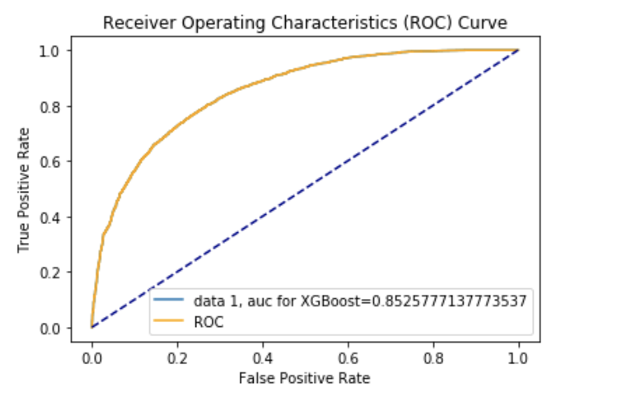
Results – AUc-ROC curve
XGBoost

Slide 16
Methods
Aim 3: Feature Importance
Gradient Boosted Trees - XGBoost
SHAP (SHapley Additive exPlanations)
Explains the output of any machine learning model

Slide 17
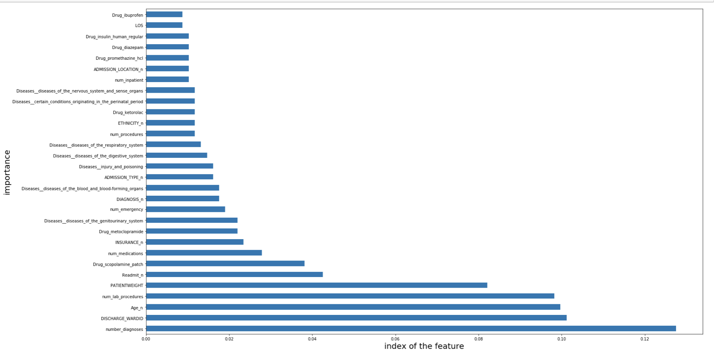
Results – Feature Importance
XGBoost

Slide 18
Results – Feature Importance
Drugs | Contribution
Drug_Scopolomine_patch | 0.03812317
Drug_metoclopramide | 0.02199413
Drug_Ketorolac | 0.01759531
Drug_Promethazine_hcl | 0.01466276
Drug_diazepam | 0.01466276
XGBoost

Slide 19
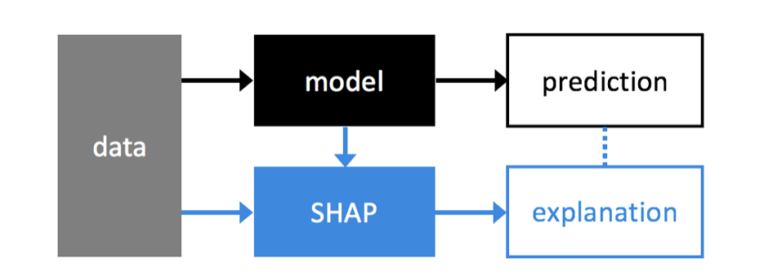
SHAP
SHAP explains the output of any machine learning model.

Slide 20
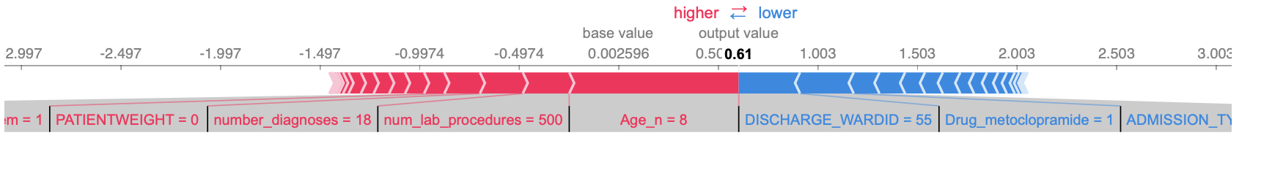
Features
Features contributing to push the model
Red indicates high and blue indicates low
Age is contributing more to push the model

Slide 21
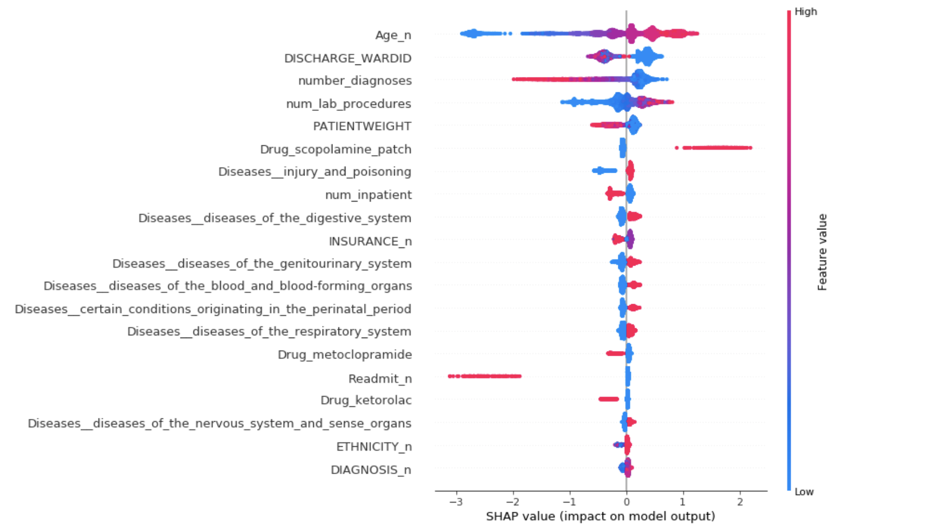
Overview of SHAP values of features
The higher the age group, the higher is the Drug_scopolamine_patch consumed by the people

Slide 22
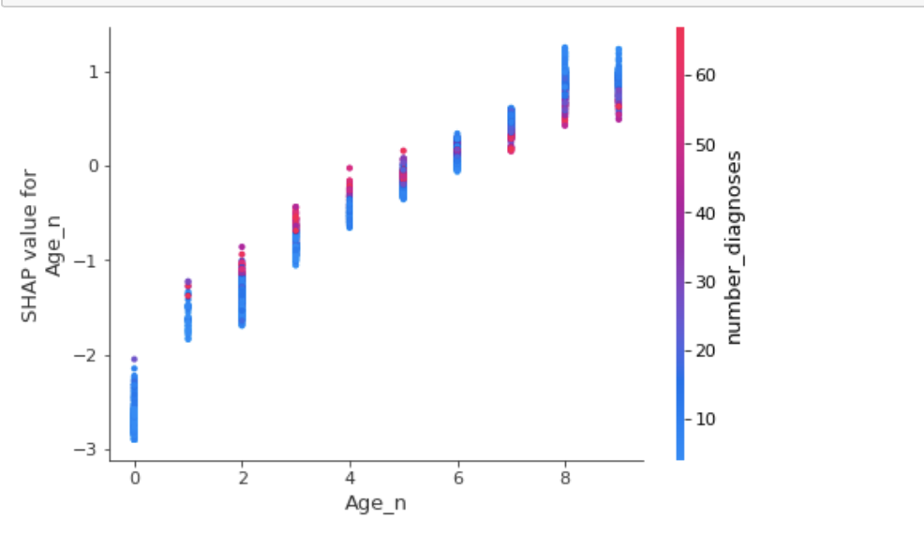
SHAP(contd…)
SHAP values of Age vs number of diagnoses
Lower age people has less impact with the number of diagnoses

Slide 23
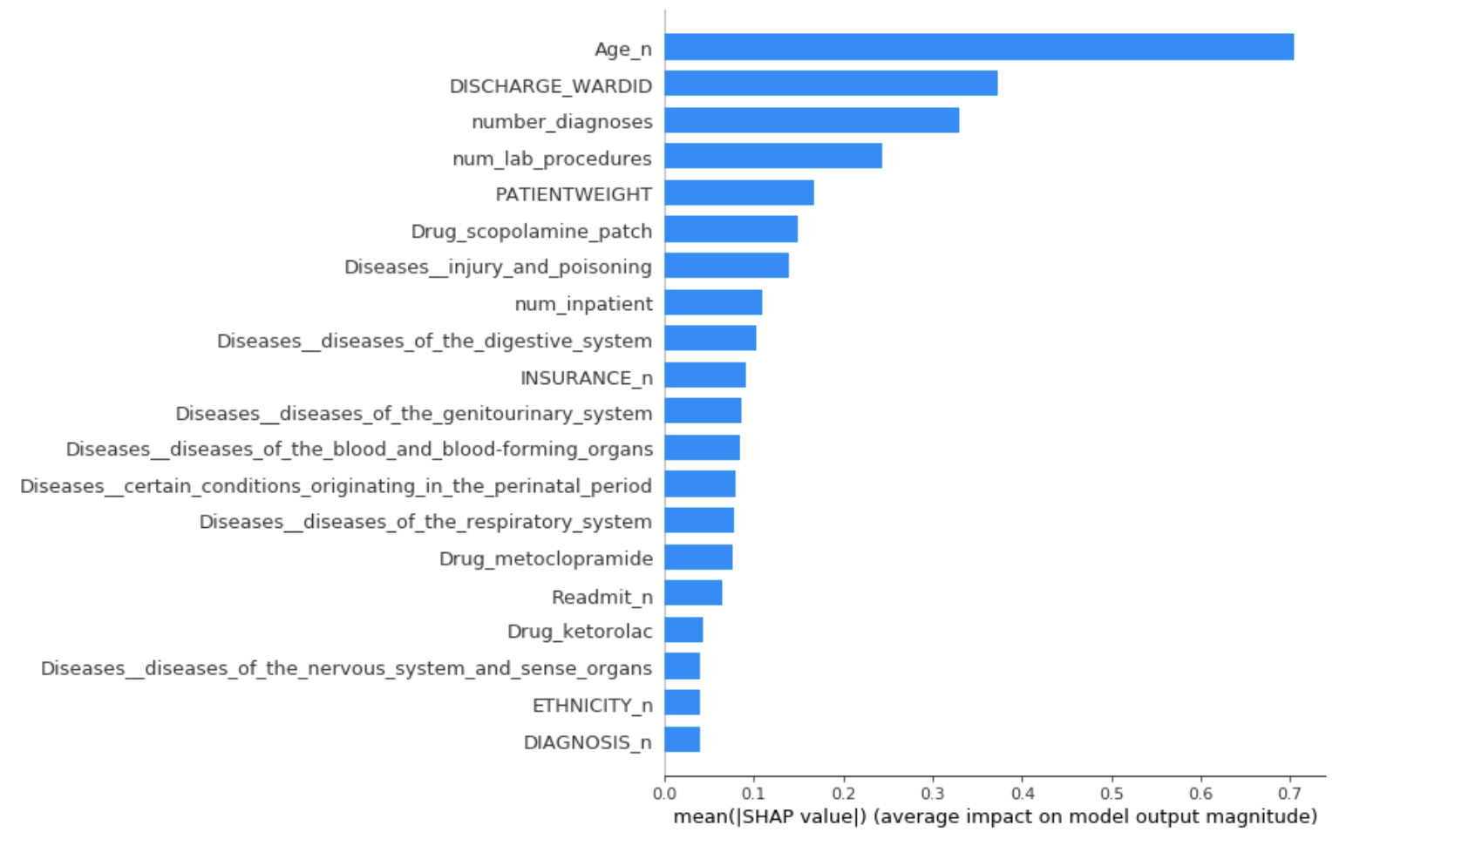
SHAP(contd…)
The mean absolute value of the SHAP values

Slide 24
Next Steps
Data can be increased from 60,000 observations to a larger number
We can increase number of medications
Apply other models

Slide 25
References
Forecasting Mortality Risk for Patients Admitted to Intensive Care Units Using Machine Learning; Hamid R. Darabi. Procedia Computer ScienceVol 140, 2018, Pages 306-313
Using electronic health record collected clinical variables to predict medical intensive care unit mortality; Jacob Calvert; Ann Med Surg (Lond). 2016 Nov;11:52-57.
Machine learning models in electronic health records can outperform conventional survival models for predicting patient mortality in coronary artery disease; Andrew J Steele; PLoS One. 2018;13(8):e0202344.
https://medium.com/berkeleyischool/how-to-use-machine-learning-to-predict-hospital-readmissions-part-1-bd137cbdba07

Slide 26
Questions?

